Slide 1
Analysing the 2016 standardized matriculation exam results
in the foreign languages: Post-test analysis
Doris Frötscher, Michael Themessl-Huber, Theresa Weiler
BMBWF, III/6
Klagenfurt, 19. Oktober 2018

Slide 2
Aims and data analysed
Evaluating the appropriatness of the CEFR target levels
Investigating potential score differences
Language | subgroup | male | female | total
English | AHS | 5,253 (42%) | 7,365 (58%) | 12,618
 | BHS | 4,237 (44%) | 5,383 (56%) | 9,620
 | Total | 9,490 (43%) | 12,748 (57%) | 22,238
French | 4 years | 129 (20%) | 530 (80%) | 659
 | 6 years | 185 (18% | 857 (82%) | 1,042
 | Total | 314 (19%) | 1,387 (81%) | 1,701

Slide 3
Research questions
What are the grade distributions of the SRDP for English and French?
What are the score distributions across the four papers Reading, Listening, Language in Use and Writing?
Are there score differences for English between male and female test takers?
Are there score differences for English between school types?
Are there score differences for French between test takers having learned French for four and six years? More specifically, are the different target levels for French reading legitimate?

Slide 4
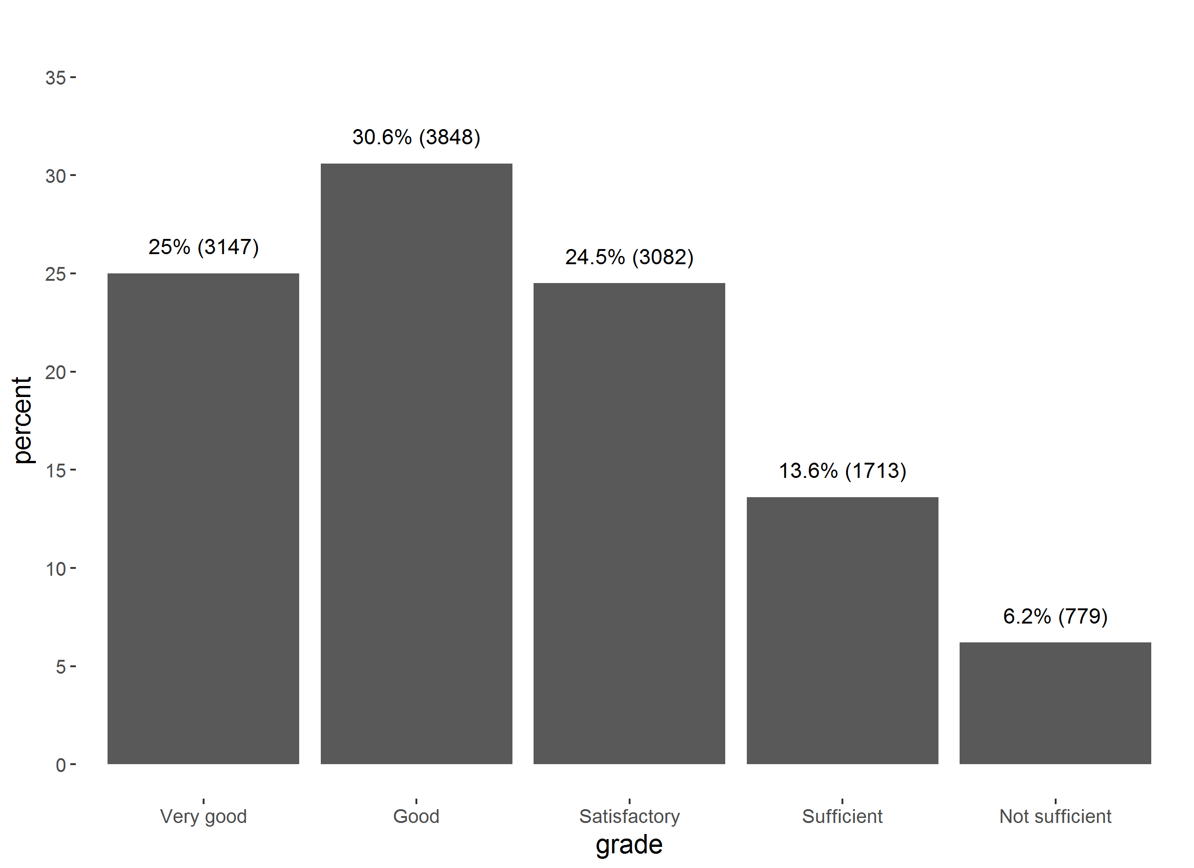
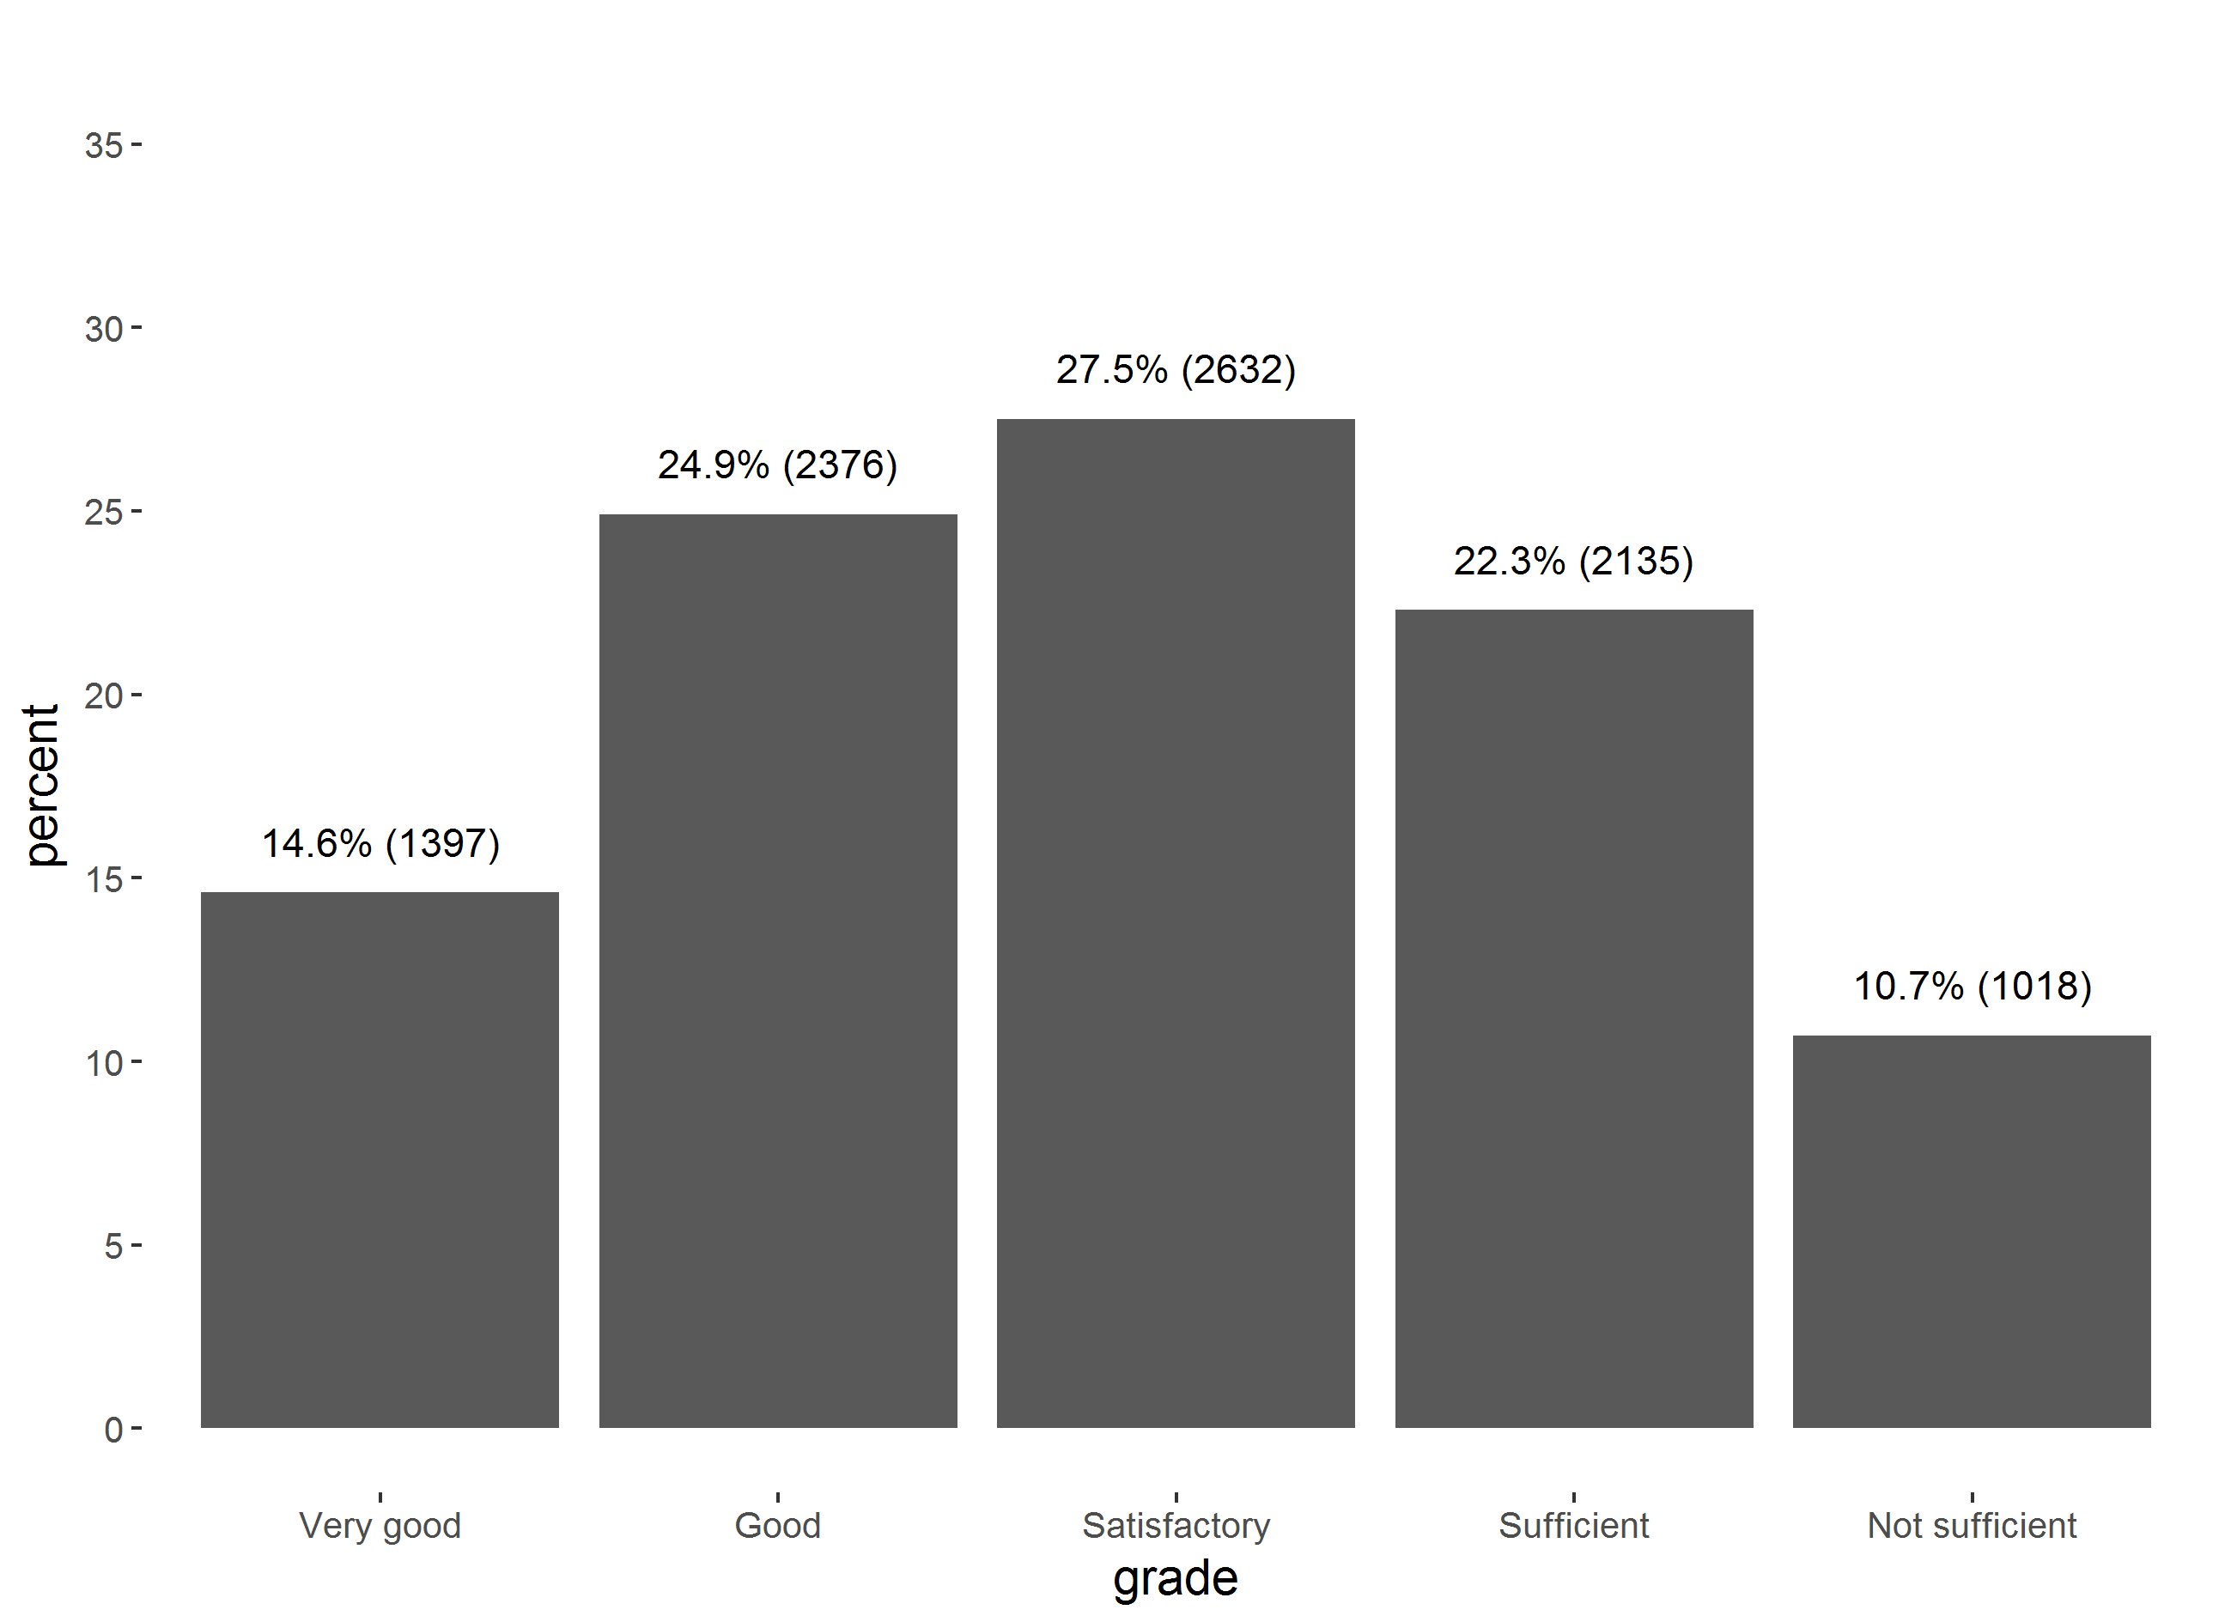
Results and discussion
English
Distribution of grades skewed to the right
Differences between AHS school types
Score variance is greater within school types than between
Differences between sexes in BHS
Distribution of sexes differs greatly between school types
Higher porportion of female test takers (subject choices?)

Slide 5
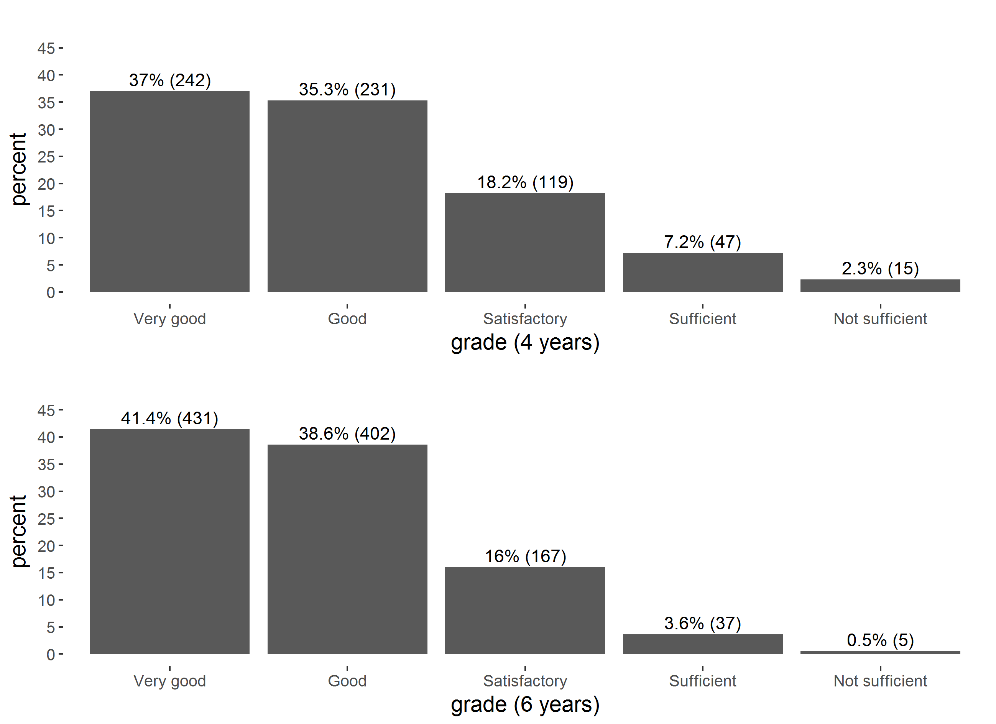
Results and discussion
French
Majority clearly reached the target levels
Ceiling effect in 6-year candidates for B1
Writing: little difference between 4- and 6-year candidates‘ scores
Teacher expectancy?

