Slide 1
On the discrepancy between rater-perceived and Empirical Item Difficulty. Standardsetting for the receptive skills in the Austrian Educational Standards Test for English
Günther Sigott & Hermann Cesnik
  Standardsetting for Reading and Listening for English E8
  Wanted to have ratings for all items (hence no bookmark method)
  CEFR ratings of Reading and Listening items by modified Angoff procedure
  Discrepancy between empirical item difficulty and estimated item difficulty
  Two approaches for linking the items to the CEFR: Fuzzy Interval Approach and Regression Approach

Slide 2
What level in the CEFR does somebody minimally have to be in order to answer this item correctly?
For somebody at this CEFR level, is the item EASY or DIFFICULT?
Tab. 1: Extract from rating sheet for Reading
Item# | Item ID | CEF Level (A1 / A2 / B1) | Difficulty within Level: E (Easy); D (Difficult)
01 | rc_feyertag05_s1
02 | rc_gritscha07_s1
03 | re_brockrai12_s1
04 | re_langnick06_s1

Slide 3
Tab. 2: Descriptive statistics for Reading items
Difficulty Index | N | Range | Minimum | Maximum | Mean |  | Std. Deviation | Variance
 |  |  |  |  | Statistic | Std. Error
EmpID | 50 | 4.88 | -2.46 | 2.42 | 0.3372 | 0.1714 | 1.2121 | 1.4693
RawDE | 50 | 3.40 | 2.20 | 5.60 | 4.0790 | 0.1175 | 0.8306 | 0.6900
zEmpID | 50 | 4.02 | -2.31 | 1.72 | 0.0000 | 0.1414 | 1.0000 | 1.0000
zRawDE | 50 | 4.09 | -2.28 | 1.82 | 0.0000 | 0.1414 | 1.0000 | 1.0000
EstID | 50 | 3.43 | 2.18 | 5.61 | 4.0796 | 0.1185 | 0.8378 | 0.7019
Tab. 3: Descriptive statistics for Listening items
Difficulty Index | N | Range | Minimum | Maximum | Mean |  | Std. Deviation | Variance
 |  |  |  |  | Statistic | Std. Error
EmpID | 49 | 4.76 | -2.72 | 2.03 | -0.0256 | 0.1686 | 1.1802 | 1.3929
RawDE | 49 | 2.71 | 3.12 | 5.82 | 4.4634 | 0.1009 | 0.7062 | 0.4987
zEmpID | 49 | 4.03 | -2.29 | 1.74 | 0.0000 | 0.1429 | 1.0000 | 1.0000
zRawDE | 49 | 3.83 | -1.91 | 1.94 | 0.0000 | 0.1429 | 1.0000 | 1.0000
EstID | 49 | 2.71 | 3.12 | 5.83 | 4.4681 | 0.1030 | 0.7207 | 0.5194

Slide 4
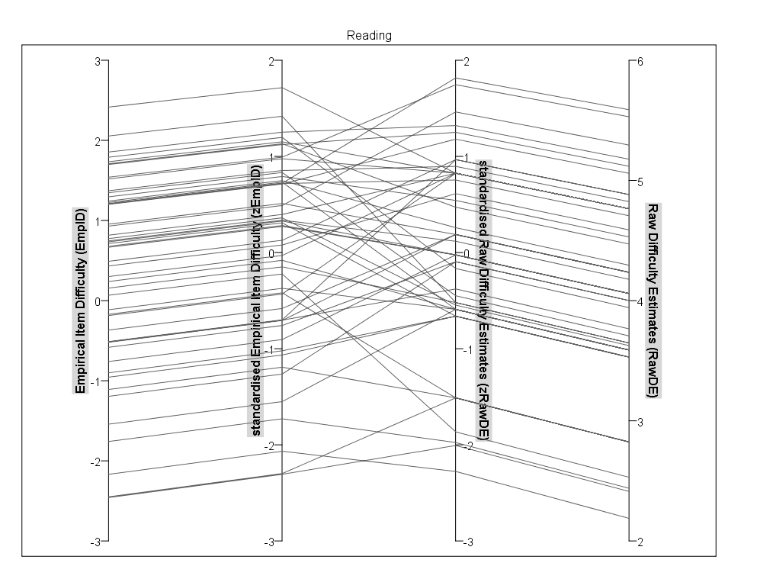
Fig. 1: Raw Difficulty Estimates and Empirical Item Difficulty of Reading items
Fuzzy interval approach: Difficulty statistics for Reading items

Slide 5
Item # | Item name | Emp ID | A1 | A2 | B1 | Level, rated (count) |  | Level, rated (score) | Diff | Raw DE | Est ID
1 | re_isakgabr17_l1 | 2.42 | 0 | 7 | 10 | B1 |  | B1 | 0 | 4.76 | 4.78
2 | re_poiselev06_s1 | 2.06 | 1 | 15 | 1 | A2 |  | A2 | 0 | 3.65 | 3.63
3 | rc_schmolmu07_l5 | 1.85 | 0 | 5 | 12 | B1 |  | B1 | 0 | 5.18 | 5.20
4 | re_langnick07_l3 | 1.79 | 1 | 12 | 4 | A2 |  | A2 | 0 | 3.94 | 3.92
5 | rc_schmolmu07_l2 | 1.73 | 0 | 7 | 10 | B1 |  | B1 | 0 | 4.76 | 4.78
6 | rc_langnick07_l4 | 1.71 | 0 | 9 | 8 | A2 |  | A2 | 0 | 4.47 | 4.47
7 | re_schmolmu07_l1 | 1.70 | 0 | 5 | 12 | B1 |  | B1 | 0 | 5.12 | 5.14
8 | rc_brockrai18_l3 | 1.54 | 0 | 2 | 15 | B1 |  | B1 | 0 | 5.53 | 5.55
9 | re_brockrai18_l1 | 1.52 | 1 | 4 | 12 | B1 |  | B1 | 0 | 4.76 | 4.78
10 | rc_schmolmu07_l4 | 1.37 | 0 | 7 | 10 | B1 |  | B1 | 0 | 4.82 | 4.84
11 | re_langnick05_s1 | 1.35 | 0 | 14 | 3 | FI_{upp} | A2 | A2 | 0 | 3.71 | 3.69
12 | re_madertha07_s1 | 1.30 | 0 | 9 | 8 | Fuzzy Interval A2-B1 | A2 | B1 | 1 | 4.53 | 4.53
13 | re_langnick07_l1 | 1.24 | 0 | 11 | 6 |  | A2 | A2 | 0 | 4.29 | 4.29
14 | re_isakgabr17_l4 | 1.23 | 1 | 13 | 3 |  | A2 | A2 | 0 | 3.59 | 3.57
15 | rc_feyertag05_s1 | 1.21 | 0 | 0 | 17 |  | B1 | B1 | 0 | 5.59 | 5.61
16 | re_isakgabr17_l3 | 1.21 | 0 | 7 | 10 |  | B1 | B1 | 0 | 4.71 | 4.72
17 | re_isakgabr17_l2 | 1.20 | 0 | 4 | 13 |  | B1 | B1 | 0 | 5.06 | 5.08
18 | re_greifene06_s1 | 0.96 | 0 | 11 | 6 |  | A2 | A2 | 0 | 4.24 | 4.23
19 | re_brockrai18_l2 | 0.93 | 0 | 4 | 13 |  | B1 | B1 | 0 | 5.29 | 5.32
20 | re_brockrai09_s1 | 0.82 | 0 | 6 | 11 | FI_{low} | B1 | B1 | 0 | 4.76 | 4.78
21 | re_wurmsmol06_s1 | 0.77 | 1 | 12 | 3 | A2 |  | A2 | 0 | 3.63 | 3.60
22 | rc_cranegra05_s1 | 0.75 | 1 | 10 | 6 | A2 |  | A2 | 0 | 4.18 | 4.16
23 | rc_gritscha07_s1 | 0.73 | 0 | 15 | 2 | A2 |  | A2 | 0 | 4.06 | 4.04
24 | re_isakgabr11_s1 | 0.71 | 0 | 15 | 2 | A2 |  | A2 | 0 | 3.53 | 3.51
25 | rc_cranegra07_s1 | 0.68 | 1 | 11 | 5 | A2 |  | A2 | 0 | 4.06 | 4.04
26 | re_brockrai12_s1 | 0.67 | 1 | 9 | 7 | A2 |  | A2 | 0 | 4.06 | 4.04
27 | rc_lackenba05_s1 | 0.49 | 0 | 7 | 10 | B1 |  | B1 | 0 | 4.88 | 4.90
28 | rc_gritscha11_l5 | 0.43 | 0 | 9 | 8 | A2 |  | B1 | 1 | 4.59 | 4.59
29 | rc_gritscha11_l4 | 0.30 | 0 | 8 | 9 | B1 |  | B1 | 0 | 4.76 | 4.78
30 | re_gritscha11_l2 | 0.24 | 0 | 13 | 4 | A2 |  | A2 | 0 | 3.59 | 3.57
31 | rc_brockrai18_l4 | 0.16 | 1 | 13 | 3 | A2 |  | A2 | 0 | 3.65 | 3.63
32 | re_langnick06_s1 | 0.07 | 8 | 9 | 0 | A2 |  | A2 | 0 | 2.53 | 2.55
33 | re_fuchseve04_s1 | -0.11 | 0 | 14 | 3 | A2 |  | A2 | 0 | 3.59 | 3.57
34 | re_langnick07_l2 | -0.17 | 2 | 15 | 0 | A2 |  | A2 | 0 | 2.82 | 2.84
35 | re_gritscha11_l1 | -0.19 | 0 | 8 | 9 | B1 |  | B1 | 0 | 4.76 | 4.78
Item # | Item name | Emp ID | A1 | A2 | B1 | Level, rated (count) | Level, rated (score) | Diff | Raw DE | Est ID
36 | re_isakgabr17_l5 | -0.37 | 0 | 10 | 7 | A2 | A2 | 0 | 4.24 | 4.23
37 | rc_brockrai18_l5 | -0.51 | 0 | 7 | 10 | B1 | B1 | 0 | 4.88 | 4.90
38 | rc_gotteinh07_s1 | -0.52 | 1 | 11 | 5 | A2 | A2 | 0 | 3.76 | 3.75
39 | rc_langnick07_l5 | -0.52 | 1 | 9 | 7 | A2 | A2 | 0 | 4.24 | 4.23
40 | rc_hospsabi05_s1 | -0.58 | 1 | 11 | 5 | A2 | A2 | 0 | 4.00 | 3.98
41 | rc_brockrai11_s1 | -0.76 | 1 | 9 | 7 | A2 | A2 | 0 | 4.06 | 4.04
42 | re_hechenbl05_s1 | -0.90 | 3 | 9 | 5 | A2 | A2 | 0 | 3.53 | 3.51
43 | rc_gritscha11_l3 | -0.96 | 1 | 12 | 4 | A2 | A2 | 0 | 3.53 | 3.51
44 | rc_schmolmu07_l3 | -1.11 | 2 | 15 | 0 | A2 | A2 | 0 | 2.82 | 2.84
45 | re_isakgabr12_s1 | -1.19 | 0 | 12 | 4 | A2 | A2 | 0 | 4.00 | 3.98
46 | rc_gritscha08_s1 | -1.54 | 0 | 13 | 4 | A2 | A2 | 0 | 3.59 | 3.57
47 | re_fuchseve06_s1 | -1.76 | 7 | 9 | 0 | A2 | A1 | 1 | 2.44 | 2.45
48 | re_isakgabr10_s1 | -2.17 | 8 | 8 | 0 | A1 | A1 | 0 | 2.19 | 2.18
49 | rc_kainighu05_s1 | -2.45 | 7 | 8 | 2 | A2 | A2 | 0 | 2.82 | 2.84
50 | rc_fuchseve05_s1 | -2.46 | 7 | 10 | 0 | A2 | A1 | 1 | 2.41 | 2.42
AM |  | 0.337 |  |  |  |  |  |  | 4.079 | 4.079
SDev |  | 1.212 |  |  |  |  |  |  | 0.830 | 0.837
Item # Item number
Item name Item ID used in item bank
EmpID Empirical Item Difficulty
A1, A2, B1 Rating frequency count at CEFR levels A1, A2 and B1
Level, rated (count) CEFR level allocation based on rating frequency count
Level, rated (score) CEFR level allocation based on Raw Difficulty Estimat.
Diff Difference between item allocation based on count and score (0=same / 1=different)
RawDE Raw Difficulty Estimates
EstID Estimated Item Difficulty
FI_{upp} (……..) Upper boundary for Fuzzy‑Interval
FI_{low} (……..) Lower boundary for Fuzzy‑Interval
Threshold between A2 and B1
Threshold between A1 and B2 (assumed)
Items in need of reclassification
A2 | B1

Slide 6
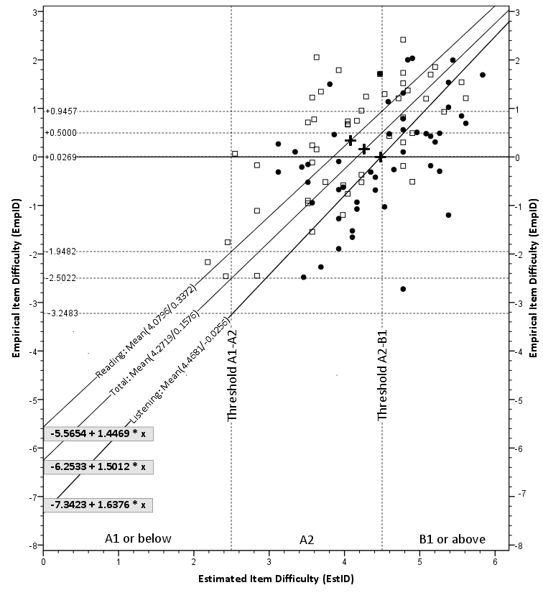
Fig. 3: Scatterplot, Regression Lines, Regression Equations,Thresholds and Cutscores

Slide 7
Tab. 11: Comparison of cutscores
Conclusions
Defining cutscores for an item bank without relying heavily on time-consuming efforts to achieve consensus among panellists is feasible.
Nevertheless high agreement should be aimed for. This is important because a shared perception of factors that determine item difficulty is an essential basis for focussing teaching on a nationwide scale.
For this reason, more research is needed that aims at identifying features of test items that are responsible for differences in empirical item difficulty (Siller & Kipman, this volume).
Threshold/Cutoff | Approach | Reading | Listening
A2 - B1 | Fuzzy unweighted | +1.085 | ‑0.010
 | Fuzzy weighted | +1.085 | +0.021
 | Regression | +0.9457 | +0.0269
A1 - A2 | Fuzzy estimated | (< ‑2.17) | (< ‑2.72)
 | Regression (extrapolated) | -1.9482 | -3.2483

